Slide 2
CHAPTER 5
The Time Value of Money

Slide 3
Time Value of Money
Time Value of Money
Future Value and Compounding
Present Value and Discounting
Finding the Interest Rate
Rule of 72
Compound Growth Rates
Exhibits

Slide 4
The Time Value of Money
    How does a manager determine the value of a series of future cash flows, whether paying for an asset or evaluating a project?
What is the value of the stream of future cash flows today?
We refer to this value as the time value of money (TVM).

Slide 5
The Time Value of Money
Consuming Today or Tomorrow
TVM is based on the belief that people prefer to consume goods today rather than wait to consume similar goods tomorrow
  Positive time preference
Money has a time value because a dollar today is worth more than a dollar tomorrow

Slide 6
The Time Value of Money
Consuming Today or Tomorrow
Today’s dollar can be invested to earn interest or spent
Value of a dollar invested (positive interest rate) grows over time
Rate of interest determines trade-off between spending today versus saving

Slide 7
The Time Value of Money
Timelines as Aids to Problem Solving
Timelines are an easy way to visualize cash flows
cash outflows as negative values
cash inflows as positive values
Go to Exhibit 5.1

Slide 8
The Time Value of Money
Future Value versus Present Value
Financial decisions are evaluated either on a future value basis or present value basis.
Future value measures what one or more cash flows are worth at the end of a specified period.
Present value measures what one or more cash flows that are to be received in the future will be worth today (at t=0).

Slide 9
The Time Value of Money
Future Value versus Present Value
Compounding is the process of earning interest over time.
Discounting is the process of converting future cash flows to their present values

Slide 10
Future Value and Compounding
Single Period Investment
We can determine the value of an investment at the end of one period if we know the interest rate to be earned by the investment.
If you invest for one period at an interest rate of i, your investment, or principle, will grow by (1 + i) per dollar invested.
The term (1+ i) is the future value interest factor, often called simply the future value factor.
Go to Exhibit 5.2 & 5.4

Slide 11
Future Value and Compounding
Two-Period Investing
A two-period investment is simply two single-period investments back-to-back.
After the first period, interest accrues on original investment (principle) and interest earned in preceding periods

Slide 12
Future Value and Compounding
Two-Period Investing
The principle is the amount of money on which interest is paid
Simple interest is the amount of interest paid on the original principle amount only
Compounding interest consists of both simple interest and interest-on-interest

Slide 13
Future Value and Compounding
The Future Value Equation
General equation to find the future value after any number of periods
The term (1 + i)^{n} is the future value factor.
We can use future value tables to find the future value factor at different interest rates and maturity periods

Slide 14
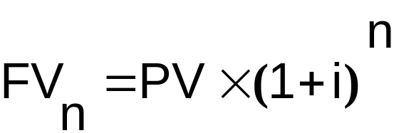
Future Value and Compounding
Equation 5.1
where:
FV_{n} = future value of investment at the end of period n
PV = original principle (P₀) or present value
i = the rate of interest per period, which is often a year
n = the number of periods

Slide 15
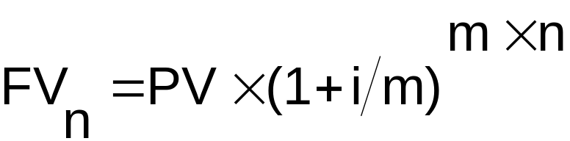
Future Value and Compounding
Compounding More Frequently Than Once a Year
The more frequently the interest payments are compounded, the larger the future value of $1 for a given time period. See equation 5.2 (below).
where: m = Number of compounding periods in a year.

Slide 16
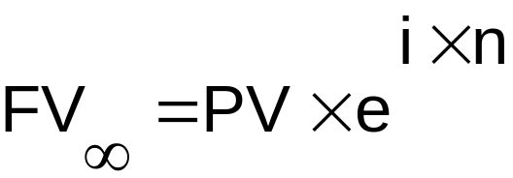
Future Value and Compounding
When interest is compounded on a continuous basis,
we can use equation 5.3 (below)

Slide 17
Present Value and Discounting
Present value calculations state the current value of a dollar in the future
This process is called discounting, and the interest rate i is known as the discount rate.
The present value (PV) is often called the discounted value of future cash payments.
The present value factor is more commonly called the discount factor.
Go to Exhibit 5.2

Slide 18
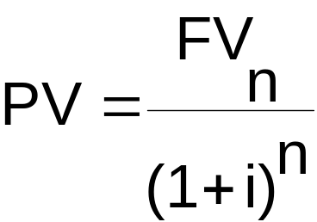
Present Value and Discounting
Equation 5.4 (below) gives us the general equation to find the present value after any number of periods.

Slide 19
Present Value and Discounting
The further in the future a dollar will be received, the less it is worth today.
The higher the discount rate, the lower the present value of a dollar.

Slide 20
Finding the Interest Rate
A number of situations will require you to determine the interest rate (or discount rate) for a given stream of future cash flows.
For an individual investor or a firm, it may be necessary:
to determine the return on an investment
to determine the interest rate on a loan
to determine a growth rate

Slide 21
The Rule of 72
Rule of 72 is used to determine the amount of time it takes to double an investment.
It says that the time to double your money (TDM) approximately equals 72/i, where i is expressed as a percentage.
Rule of 72 is fairly accurate for interest rates between 5% and 20%.

Slide 22
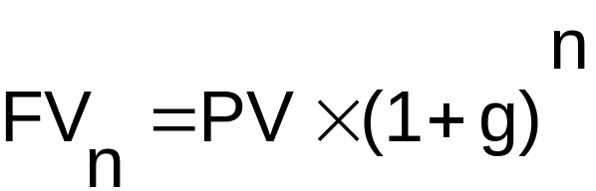
Compound Growth Rates
Compound growth occurs when the initial value of a number increases or decreases each period by the factor (1 + growth rate)
  Examples include population growth, earnings growth
Go to Exhibit 5.4

Slide 23
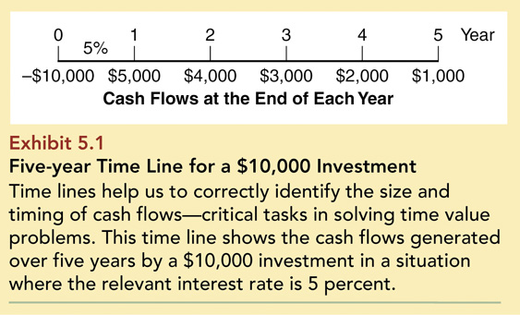
Exhibit 5.1: Five-year Time Line for $10,000 Investment

Slide 24
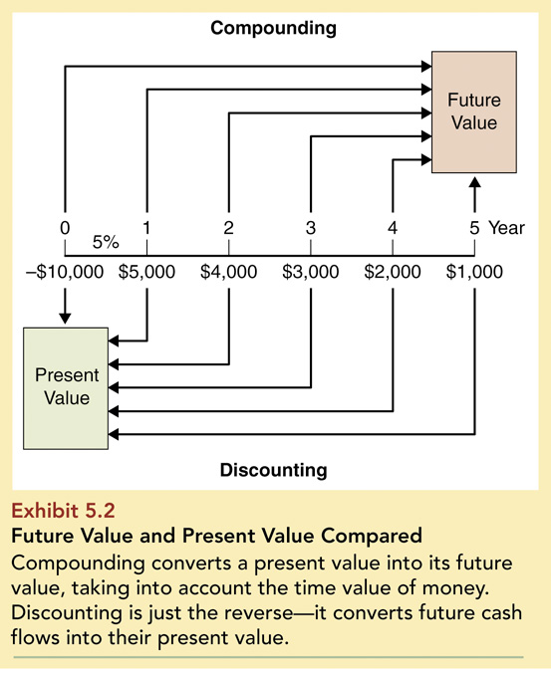
Exhibit 5.2: Future Value & Present Value Compared

Slide 25
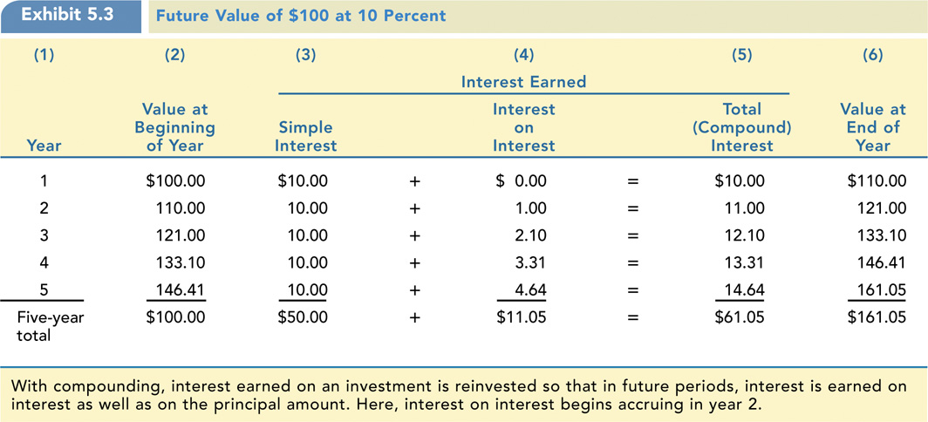
Exhibit 5.3: Future Value of $100

Slide 26
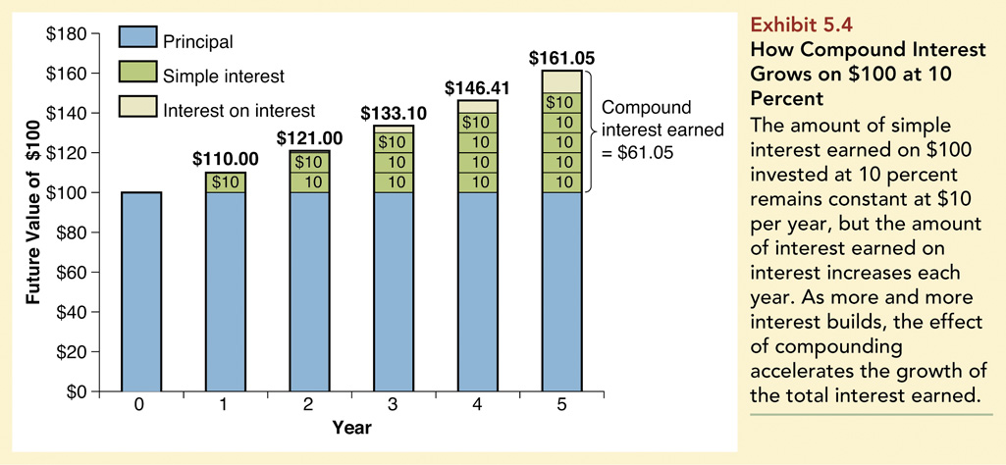
Exhibit 5.4: How Compound Interest Grows

Slide 27
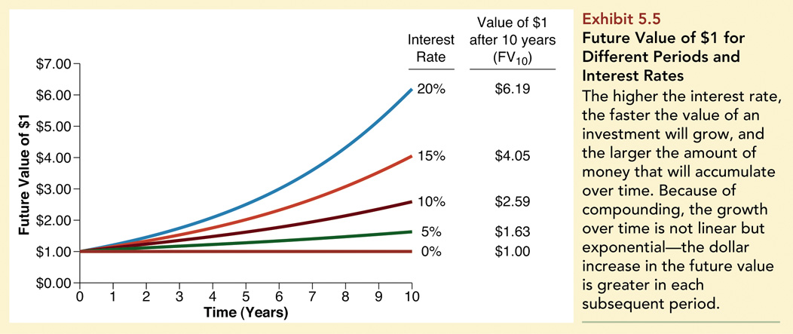
Exhibit 5.5: Future Value of $1

Slide 28
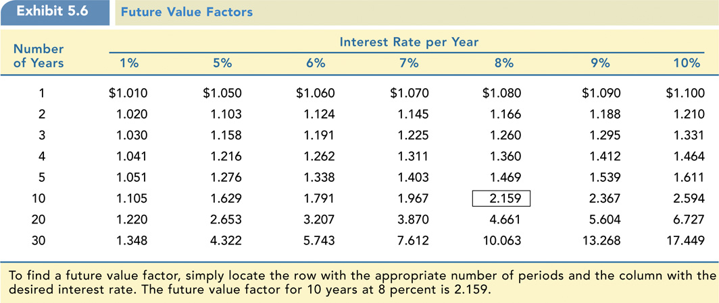
Exhibit 5.6: Future Value Factors

Slide 29
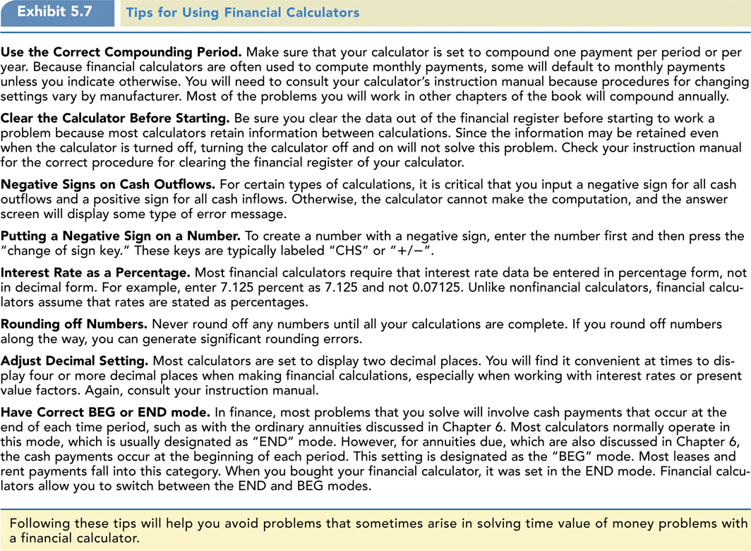
Exhibit 5.7: Tips for Using Financial Calculators

Slide 30
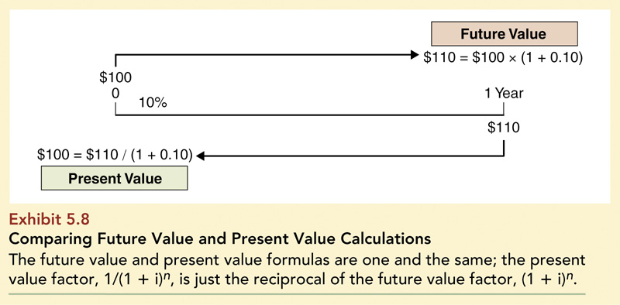
Exhibit 5.8: Comparing Future Value & Present Value Calculations

Slide 31
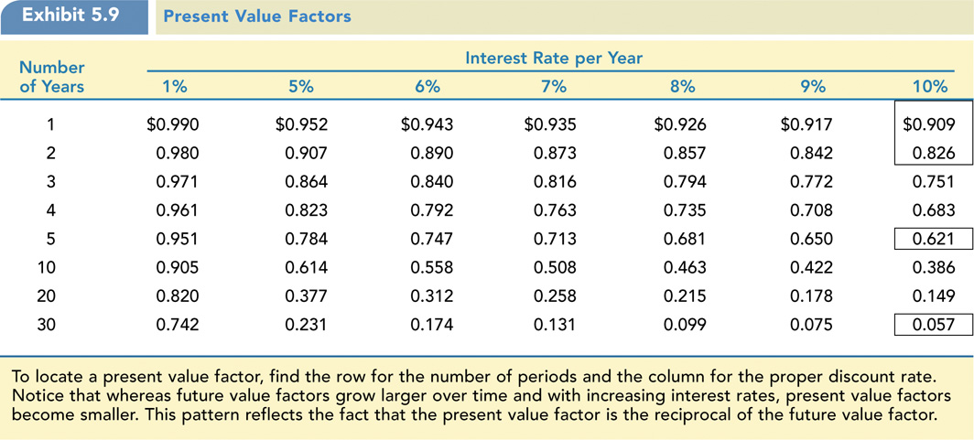
Exhibit 5.9: Present Value Factors

Slide 32
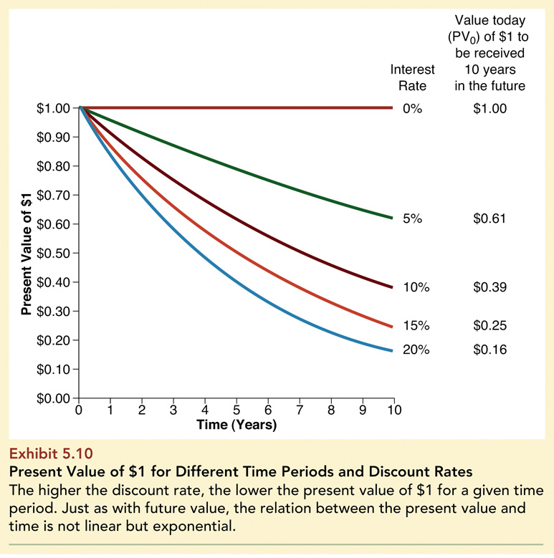
Exhibit 5.10: Present Value of $1

